Slide 1

Deep learning architecture for classifying diabetic retinopathy based on segmented fundus image features
By
1). Srikanth K - 124015163
2). Harish P - 124003420
3). Chiranjeevi - 124158015
Guided by
Ms. Gowri L
Asst. Professor - II

Slide 2
Base paper Details
Base paper : Deep learning architecture based on segmented fundus image features for classification of diabetic retinopathy.
Year : 2021
Journal name : Biomedical Signal Processing and Control
Base paper url:
https://www.sciencedirect.com/science/article/abs/pii/S174680942100197X

Slide 3
Problem Statement
Diabetic retinopathy is ophthalmological distress caused by clots, lesions, or bleeding in the light sensitive area of the retina in diabetic patients.
Blocking of vessels causes new vessel growth, which gives birth to mesh-like structures, which are caused by an increase in blood sugar.
Ophthalmologists must assess the branching retinal vasculature to provide an accurate diagnosis.

Slide 4
Proposed Solution
Blood clots/blobs, exudates, and abnormal growth of blood vessels can be observed in the fundus of patients suffering from Diabetic retinopathy.
A Diabetic retinopathy detection and classification algorithm that uses CNN.

Slide 5
Literature Survey
Proposed by | Work done | Method used | Accuracy | Dataset | Year
Dulanji et al | optic disc detection | Performed different morphological operations for accurate detection of exudates | 94.5% | DIARETD1 | 2019
Andonova et al | Classification of images using CNN with 4 convolutional layers | Input images are preprocessed ,transformed and normalized. For classification they are split into multiple groups (clusters) | 82.5% | MESSIDOR | 2018

Slide 6
Literature Survey
Proposed by | Work done | Method used | Accuracy | Dataset | Year
Avula et al | detect exudates in retinal images | Deep learning model , generated an image with hard exudates by predicting the class of each pixel | 98.29% | IDRiD (Indian Diabetic Retinopathy image Dataset) | 2018
Hemanth et al | Validation of fundus images using CNN | Image processing with histogram equalization and classification using CNN | 94% | IDRiD (Indian Diabetic Retinopathy image Dataset) | 2019

Slide 7
Objectives
Extract the Blood Vessels from fundus scan images
Classifying them into normal and abnormal classes

Slide 8
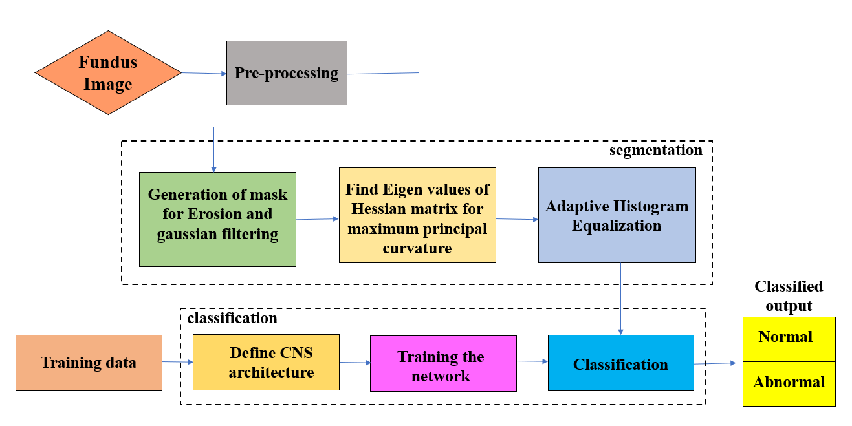
Work Flow

Slide 9
Dataset
We employ the DIARETDB1 (standard Diabetic Retinopathy Dataset) and a dataset provided by a medical institution, which includes fundus images of both damaged and normal retinas, to evaluate the proposed algorithm's performance
Data set URL : https://www.it.lut.fi/project/imageret/diaretdb1/

Slide 10
Work Carried Out
DIARETDB1 dataset is downloaded which contains fundus images.
Augmentation
Pre-processing of the fundus images are done.
The pre-processed images are subjected to segmentation.
Segmented images are classified using CNN algorithm
Validation is done on external images.

Slide 11
Work Carried Out
Augmentation
As the Dataset contains less images, augmentation is carried out to increase dataset.
Before Augmentation 348 images
Normal Images -> 93
Abnormal Images->255
Every image is rotated in 45,90,135,180,225,270,315 degrees with specific properties to form new images.
After augmentation we increased images to 2272
Normal images -> 615
Abnormal images -> 1657

Slide 12
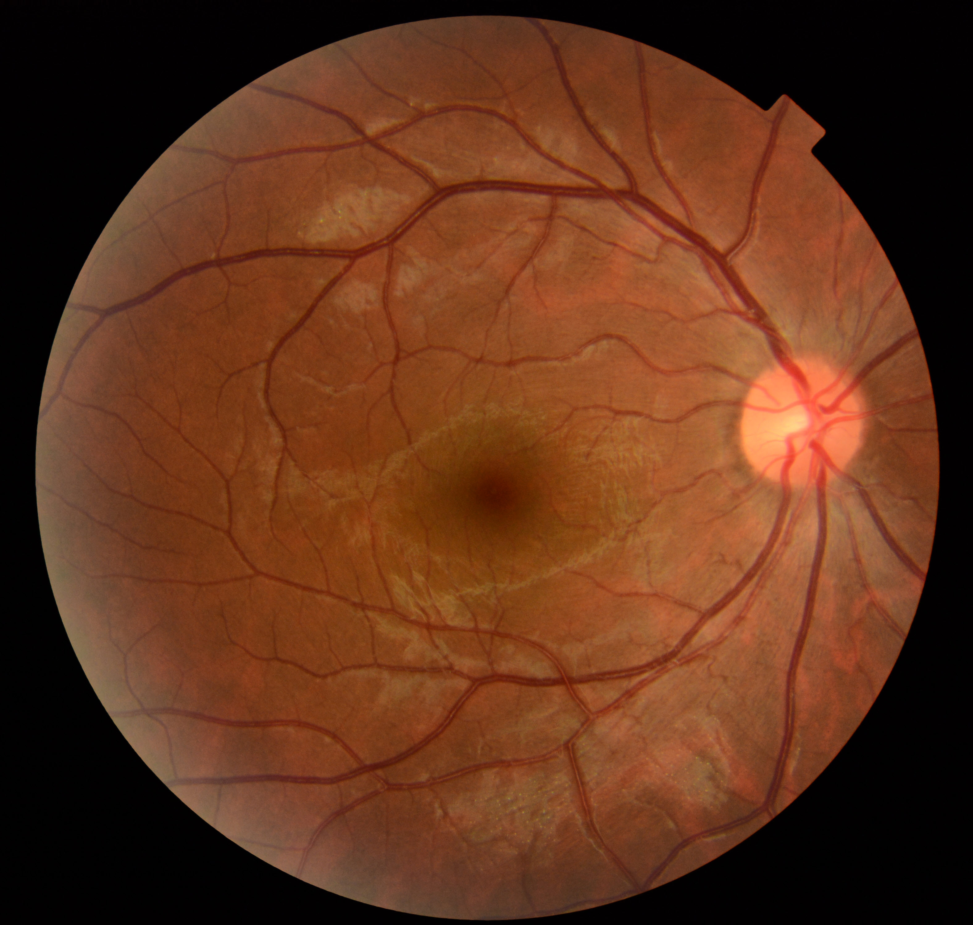
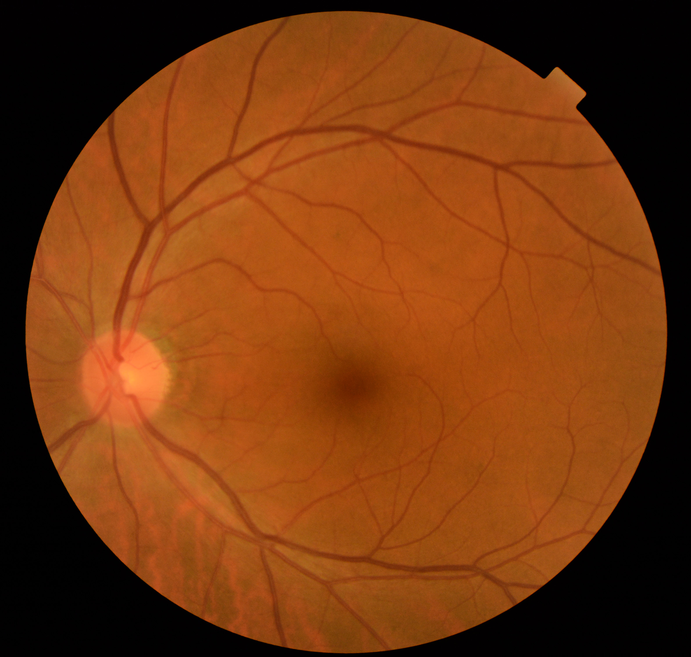
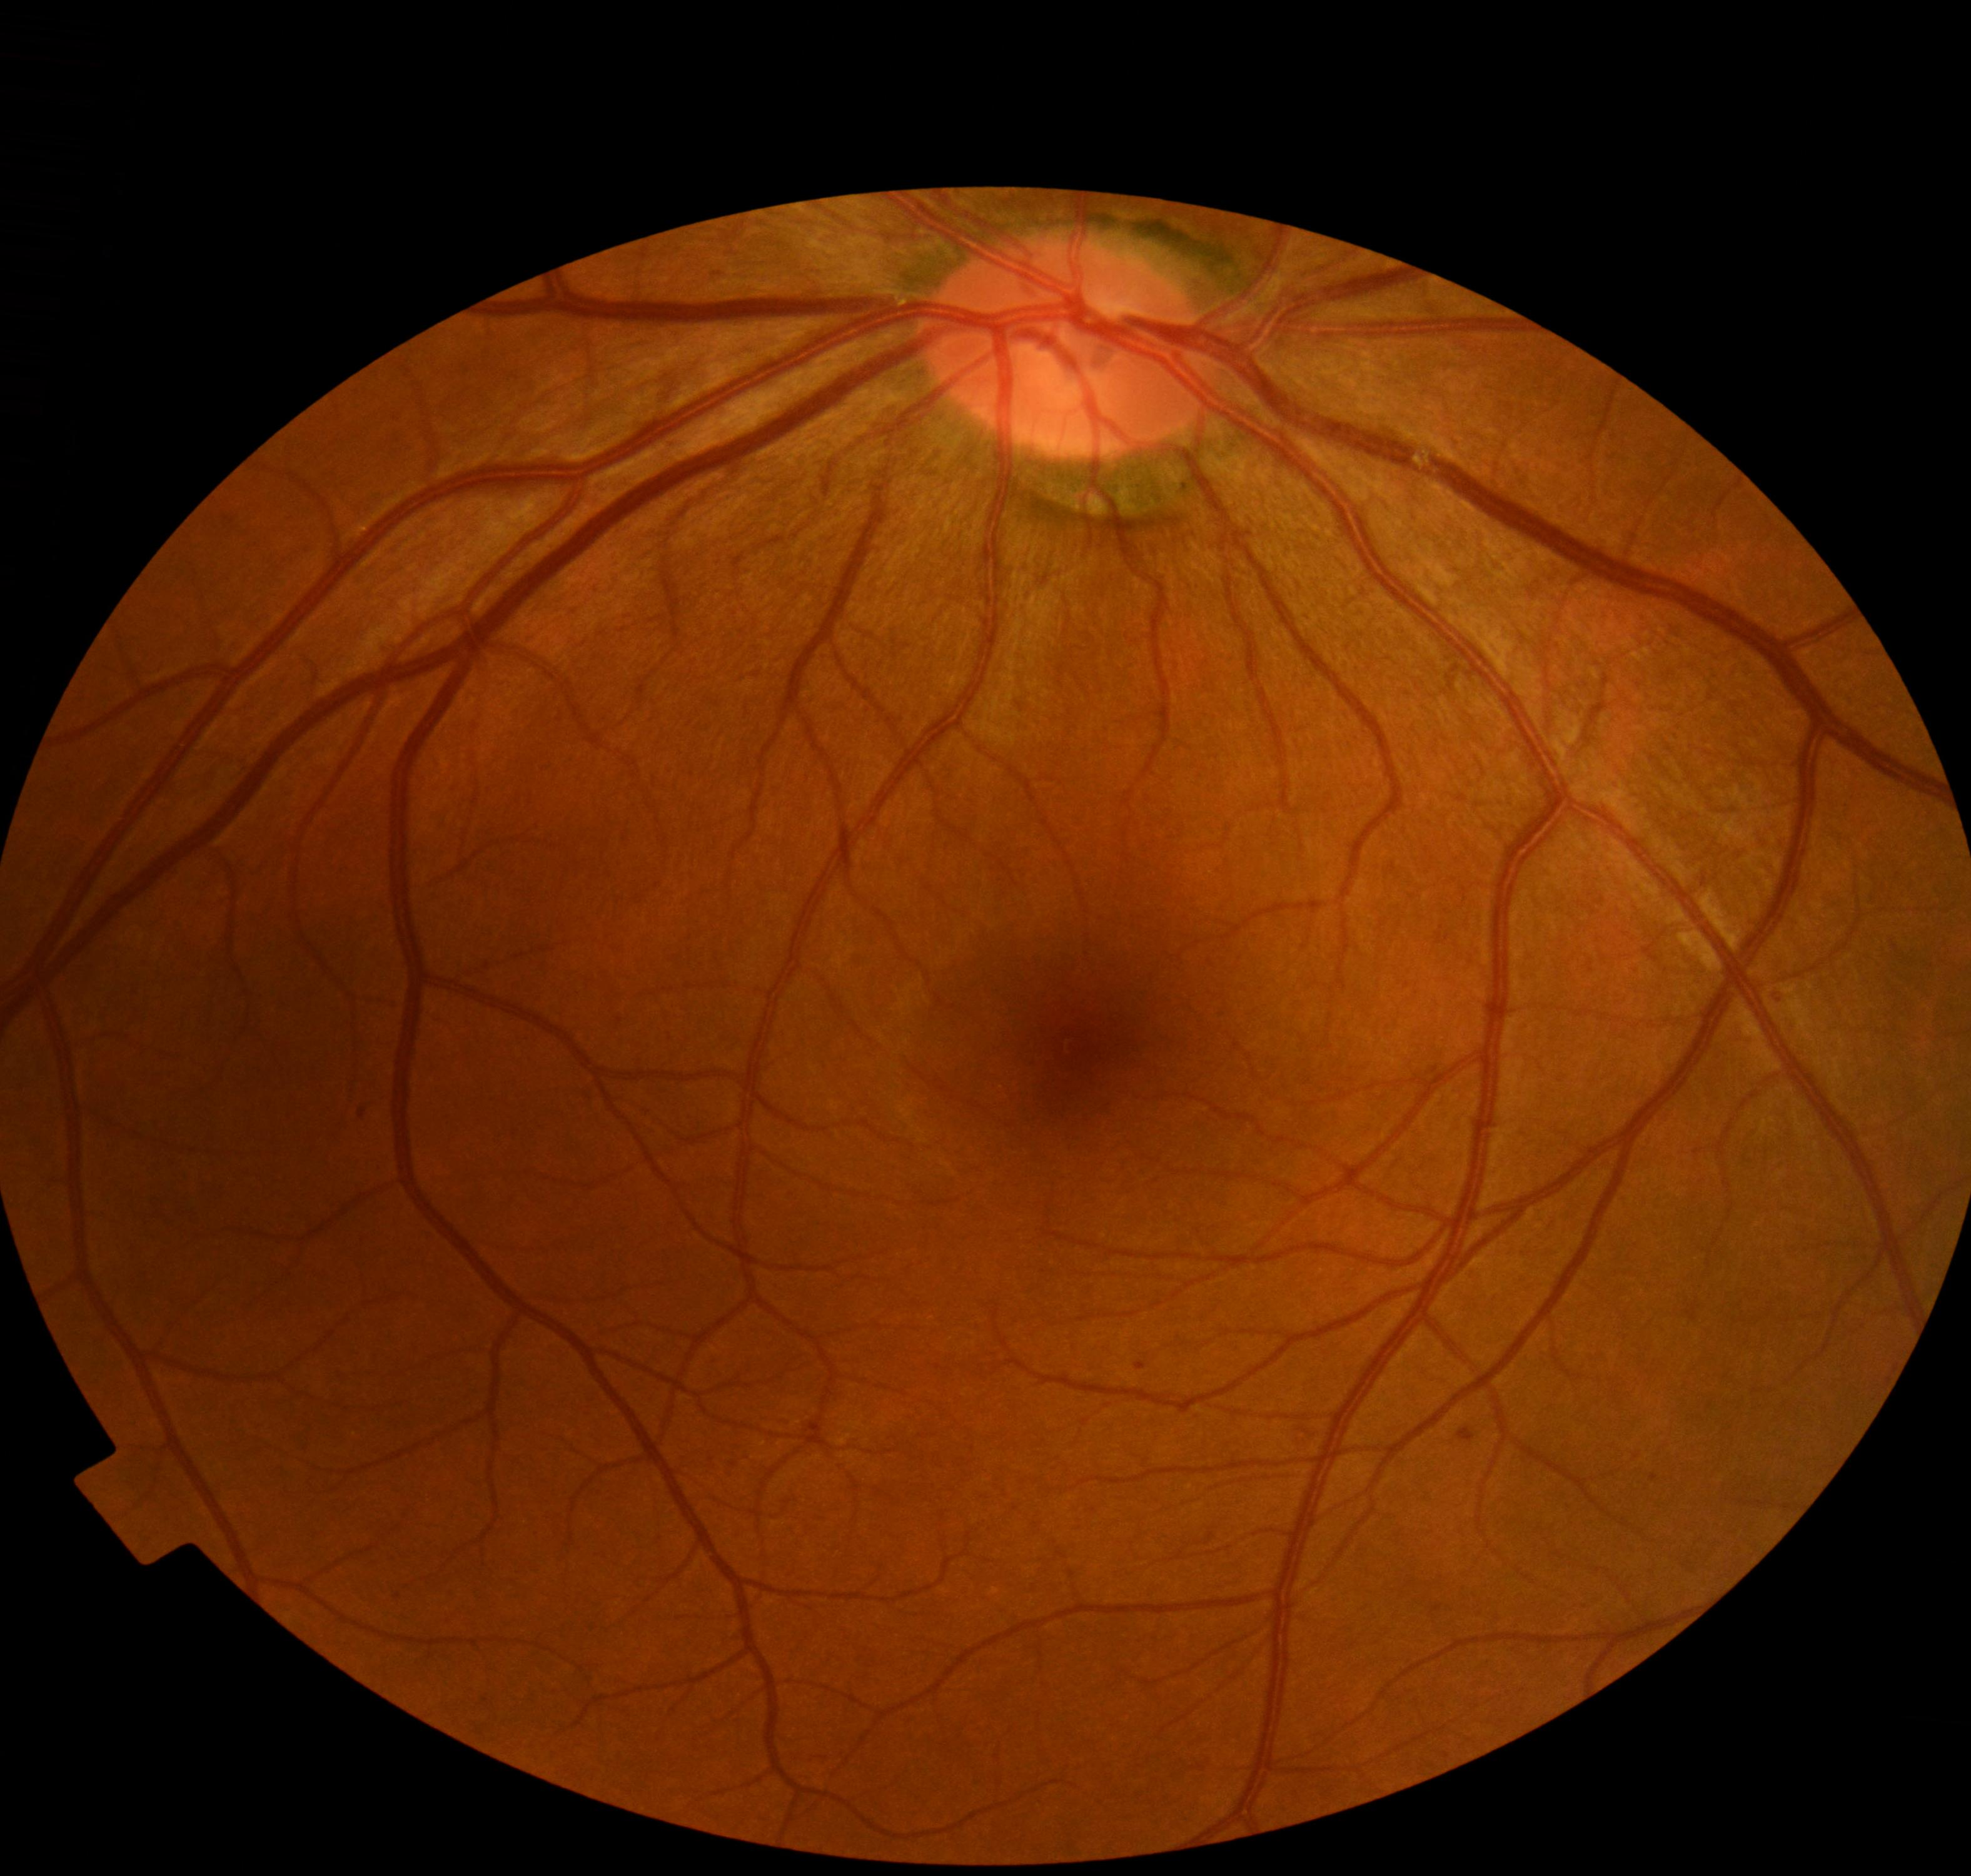
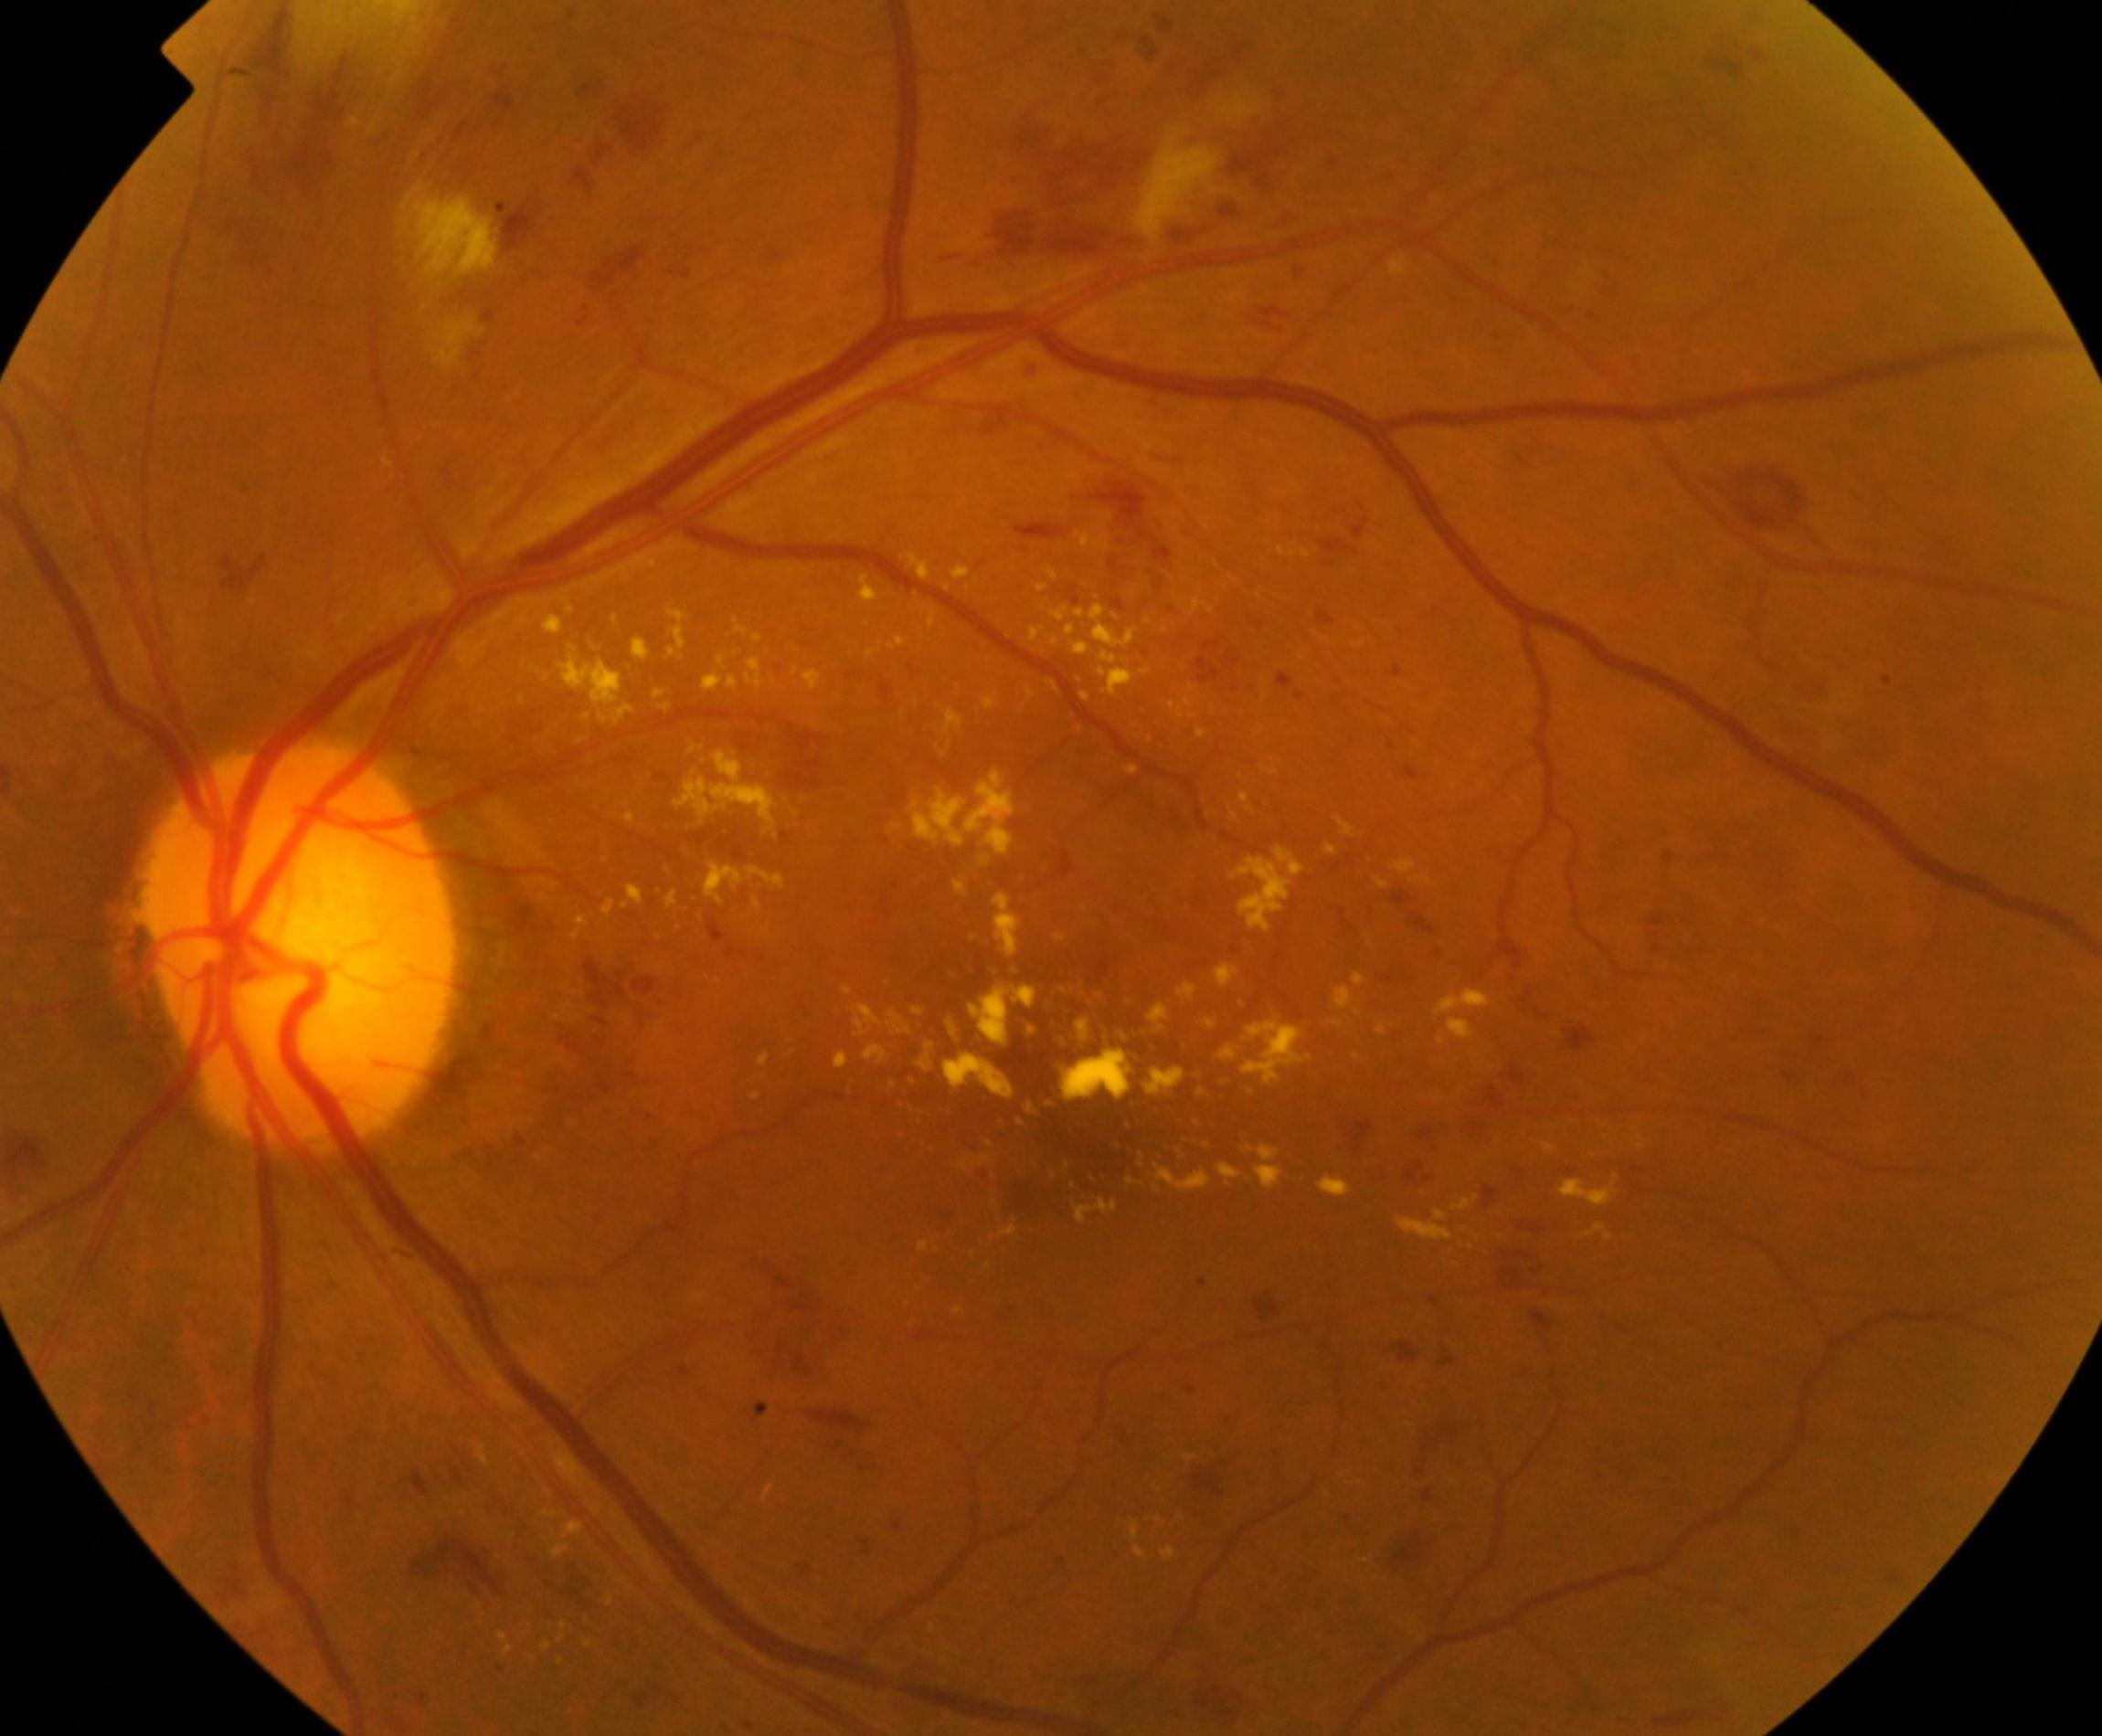
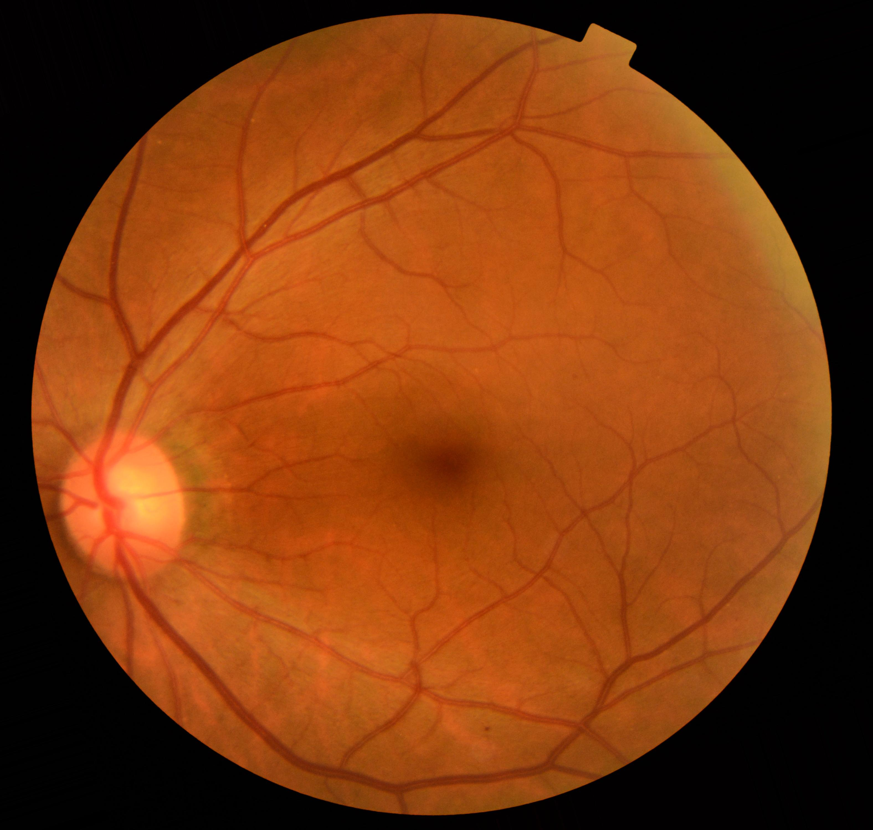
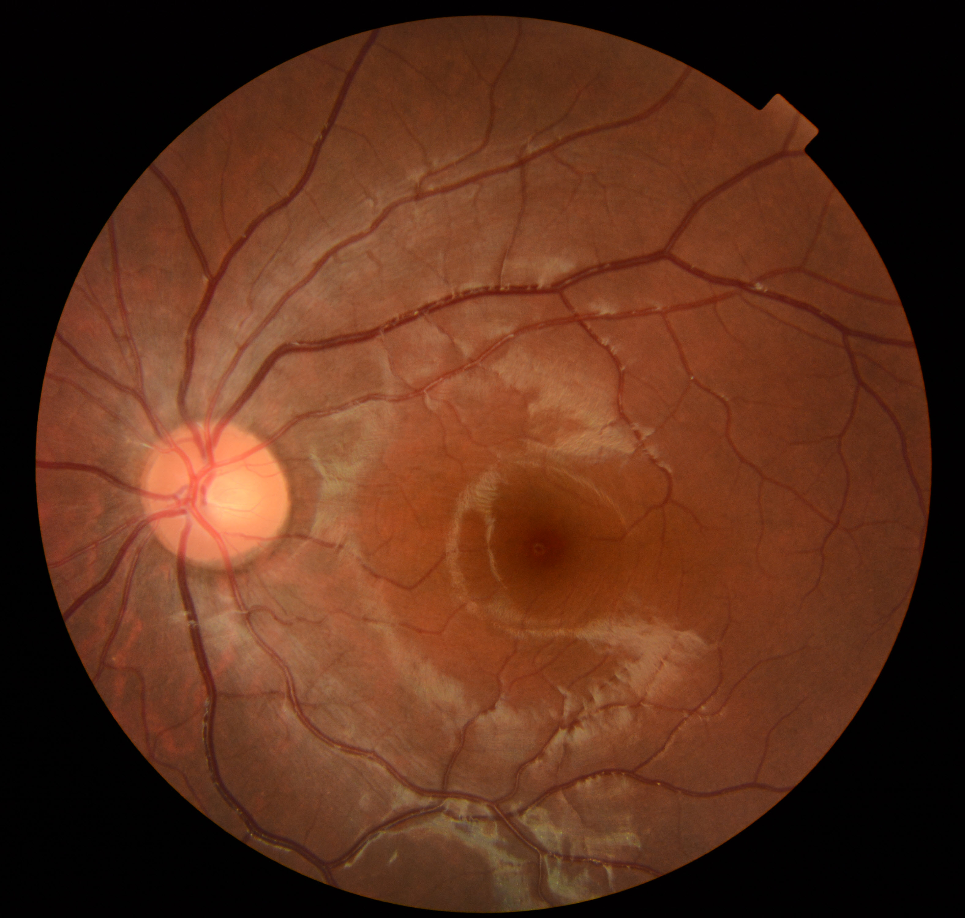
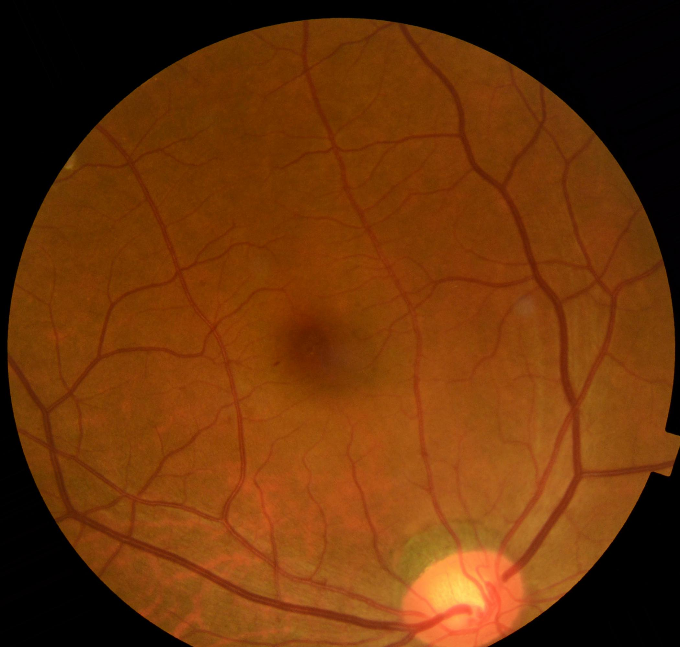
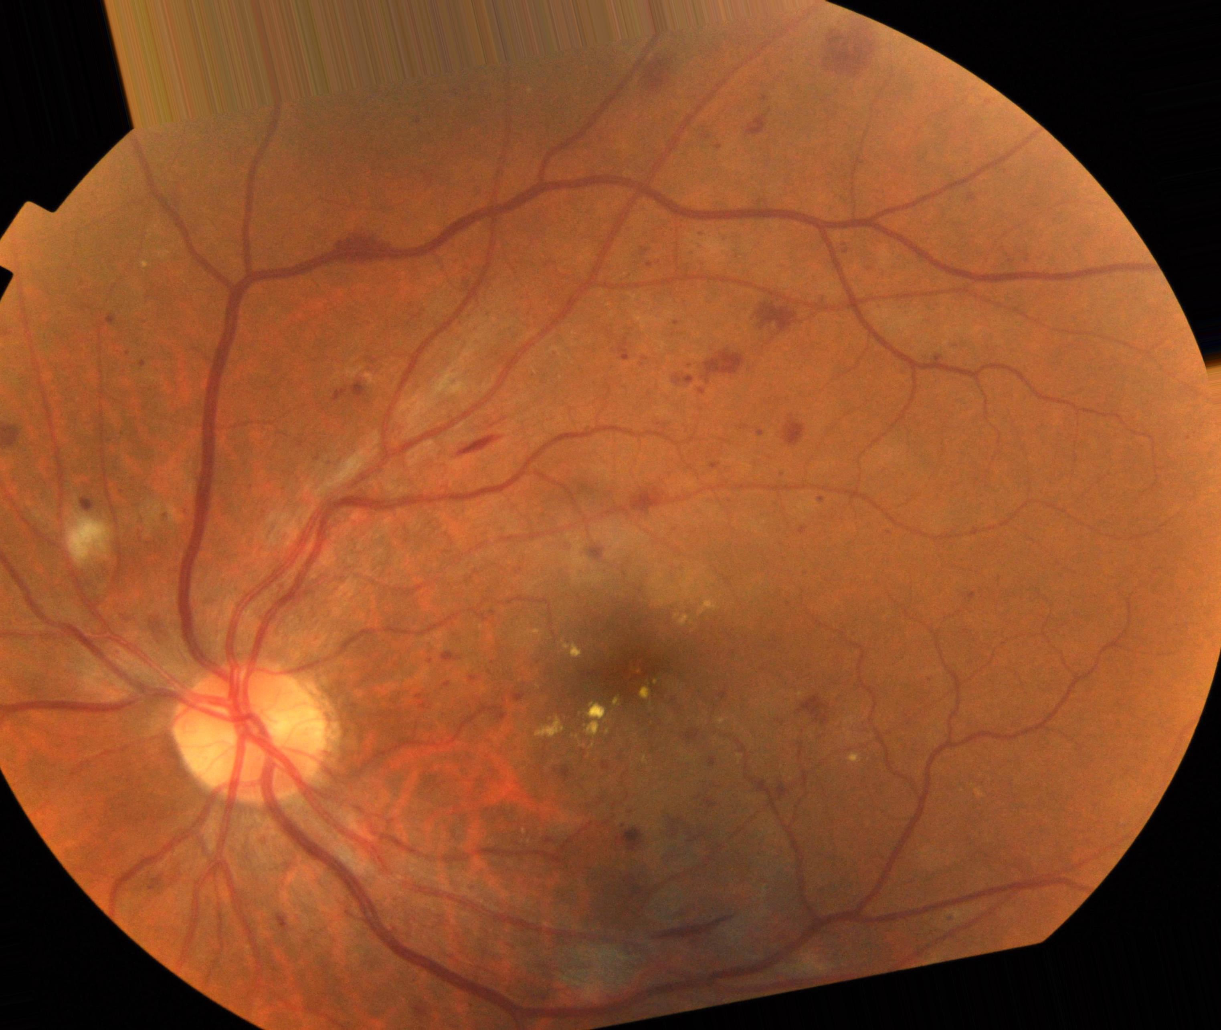
Augmentation Sample Output
Input Images
After Augmentation

Slide 13
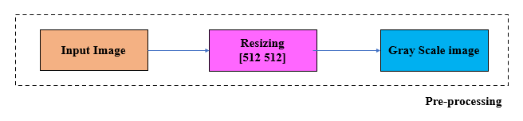
Work Carried Out
Preprocessing
Input Color Image
Resizing the image using imresize(image,[x y])
Converting into Grayscale image using rgb2gray(image)

Slide 14
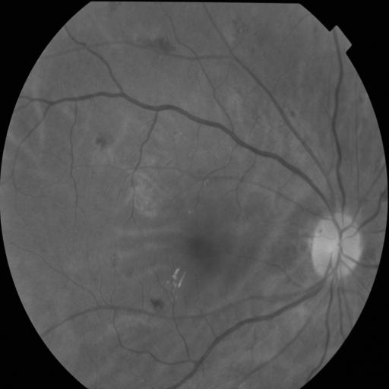
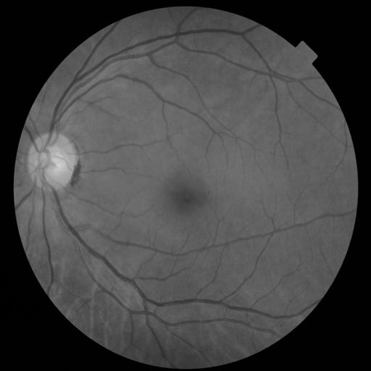
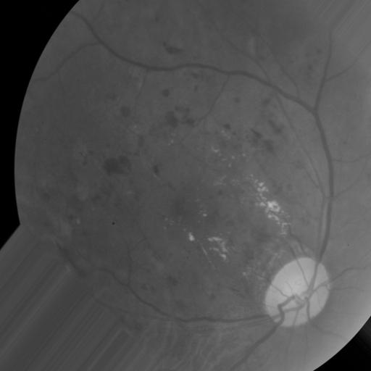
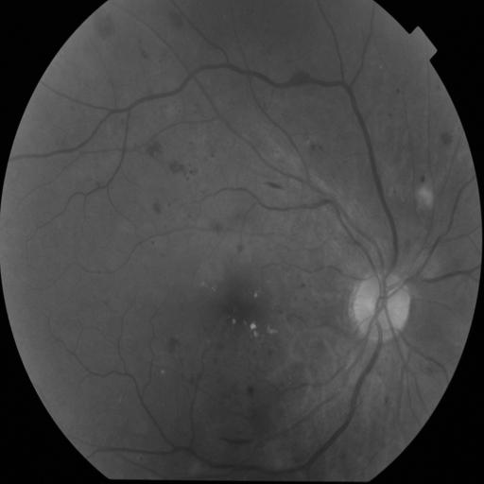
Preprocessing Sample Output
Input Images
After Preprocessing

Slide 15
Work Carried Out
Segmentation
The pictures are segmented using edge detection, which isolates the fine blood vessels efficiently.
Then, to enhance and reject erroneous sections, adaptive histogram equalization and morphological opening are used.

Slide 16
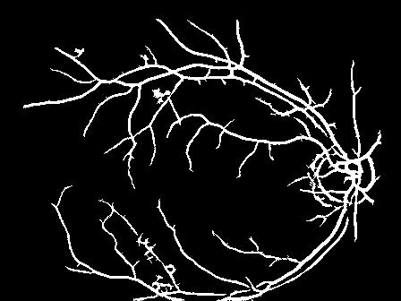
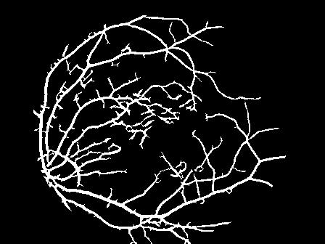
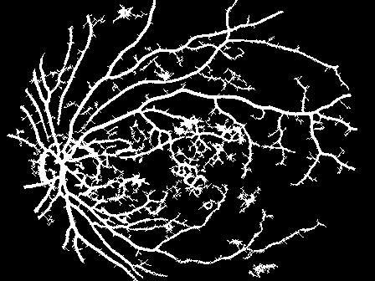
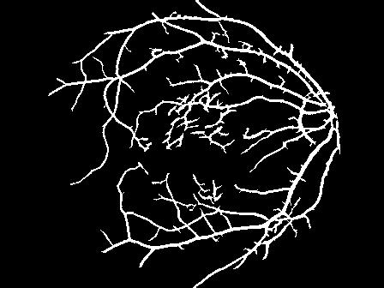
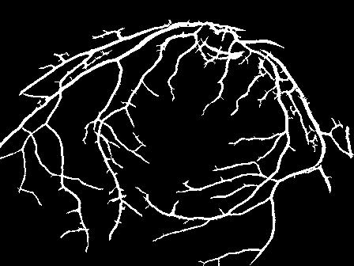
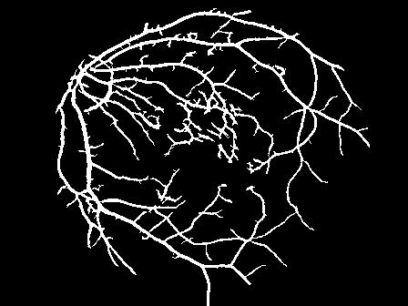
Segmentation Sample Output
Input Images
After Segmentation

Slide 17
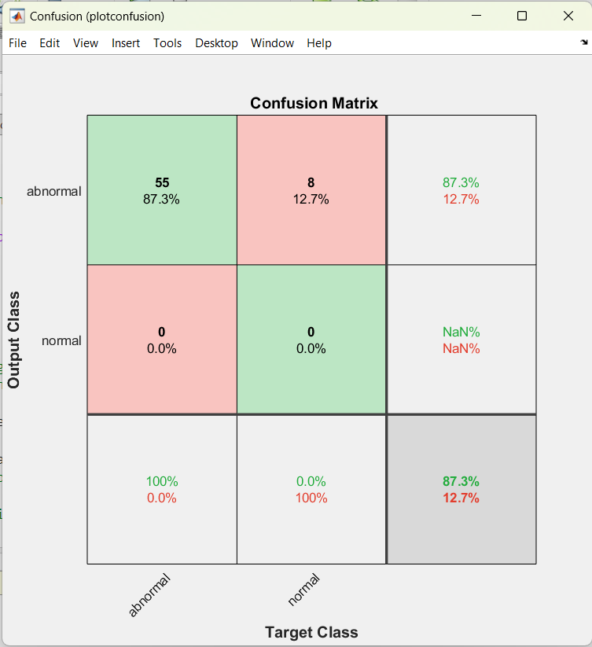
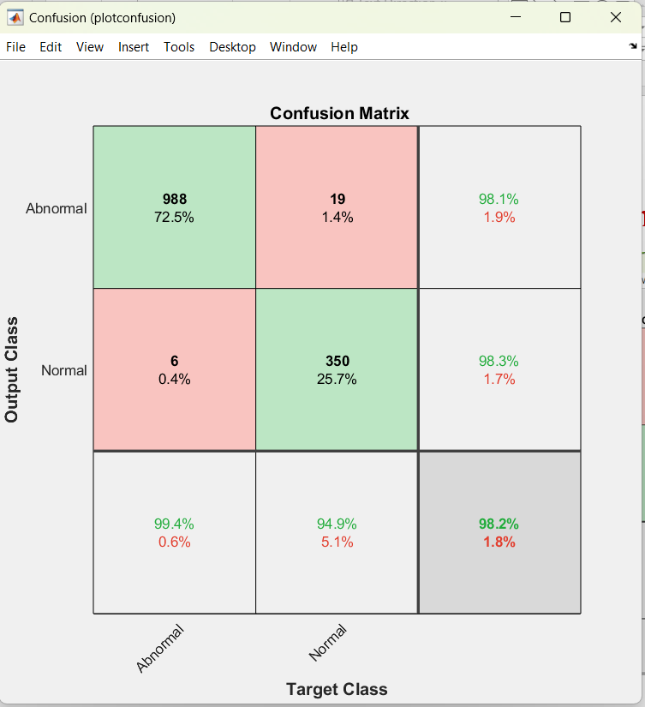
Classification Output
Without Augmentation
With Augmentation

Slide 18
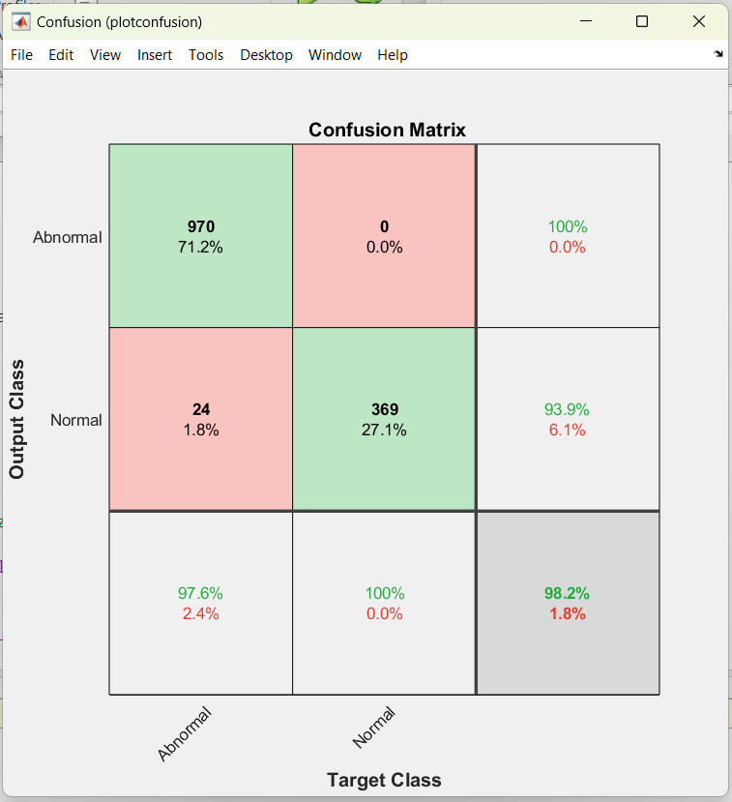

Classification Output

Slide 19


Classification Output

Slide 20
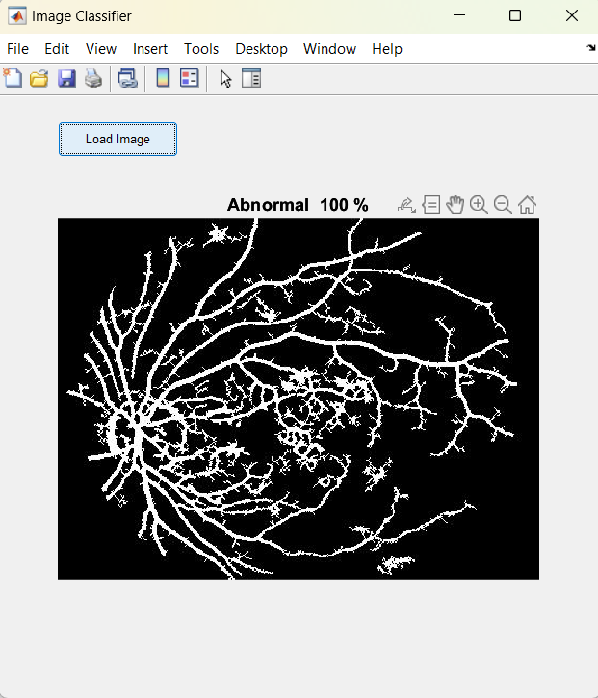
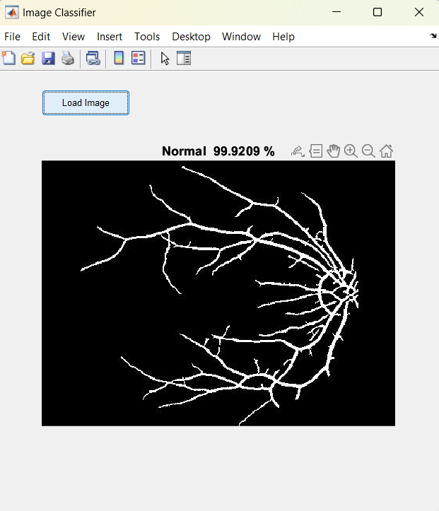
Validating an image

Slide 21
Conclusion
The trained model attained different accuracies when trained repeatedly.
The highest accuracy we got for the trained model is 98.2%.
Precision is 98.2%, Specificity is 98.4%, Sensitivity / Recall is 97.1% , and accuracy is 98.2%.
The images are classified as abnormal which means the patient is affected with fundus.

Slide 22
Conclusion
A CNN-based Diabetic Retinopathy Detection and Classification Algorithm was proposed. In the fundus of patients with DR, blood clots/blobs, exudates, and aberrant blood vessel development can be seen.
The photos are first pre-processed, and then the branching blood veins are retrieved using segmentation process.
The images are classified as abnormal which means the patient is affected with fundus.

Slide 23
References
N.C. Santosh, Y. Radhika, Optimized maximum principal curvatures based segmentation of blood vessels from retinal images, Biomed. Res. (2019).
Gehad Hassan, Nashwa El-Bendary, Aboul Ella Hassanien, Aly Fahmy, M. Shoeb, Vaclav Snasel, Retinal blood vessel segmentation approach based on mathematical morphology, Procedia Comput. Sci. 65 (2015) 612–622.
K. Lyu, Y. Li, Z. Zhang, Attention-aware multi-task convolutional neural networks, IEEE Trans. Image Process. 29 (2020) 1867–1878.
Thomas A. Siji, Titus Geevarghese, Design of a portable retinal imaging module with automatic abnormality detection, Biomed. Signal Process. Control 60 (2020).

Slide 24
Thank you

